Slide 1
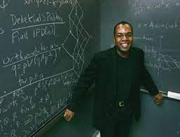
Ron is an assistant professor of mathematics at a university

Slide 2

Ron doesn’t live close enough to the university to use public transit

Slide 3
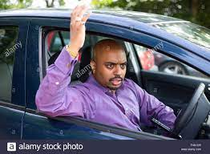
He needs to be on time for his class, but struggles to find parking in the mornings. And doesn’t want to pay the university for a parking pass (they’re price gouging)

Slide 4

After arriving late to yet another class period, Ron is reprimanded by his boss. He hears about <Parking App> from another professor during his lunch, and decides to give it a try

Slide 5
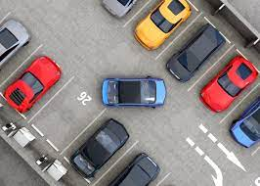
<Parking App> shows him the heaviest trafficked times and shows him where available spaces are

Slide 6

Ron makes all of his classes on time and hasn’t been reprimanded again. His parking troubles are over

